Slide 1



Coursera Applied Data Science Capstone
IBM Data Science Professional Certificate
August 2021

Slide 2


Finding the Best Neighborhood for a Chicago Sports Fan
Lucas Rytel

Slide 3
Introduction
Chicago, Illinois is the 3rd largest city in the United States, divided into 178 different neighborhoods per the Chicago municipal code.
Along with the rich history of the city, Chicago is also home to 5 of the most popular professional sports teams in the world – the Chicago Bulls, Chicago Bears, Chicago Blackhawks, Chicago Cubs, and Chicago White Sox.
The city is very proud and passionate about their teams. This raises the question – as a diehard Chicago sports fan, what are the best neighborhoods to live in?

Slide 4

Business Problem
We will be exploring the different neighborhoods in Chicago to see what each has to offer. For the purpose of this project, we will be considering two main criteria: proximity to stadiums (where the teams play) and proximity to the best sports bars in Chicago. Where is the best place for the city’s biggest sports fans?

Slide 5
Data
As the capstone project for this IBM course, we will be leveraging our new data science knowledge to help us answer our question.
Similar to our exploration of New York and Toronto neighborhoods, we will start with a list of neighborhoods and begin building our map with latitude and longitude coordinates. The Foursquare API will take us a step further, providing venue data for sports bars and stadiums.
Throughout our analysis, we will work the data into a clean dataframe, plot maps to visualize, and document our step-by-step process in the final report.

Slide 6
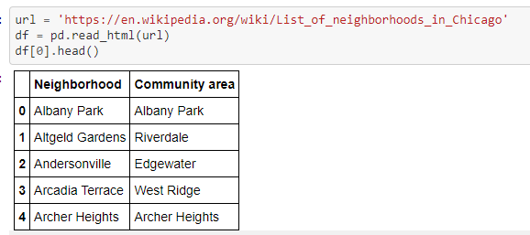
List of Neighborhoods
First we need to retrieve our list of Chicago neighborhoods, this is done using the Wikipedia resource below
https://en.wikipedia.org/wiki/List_of_neighborhoods_in_Chicago
According to Wikipedia, there are over 200 neighborhoods:

Slide 7
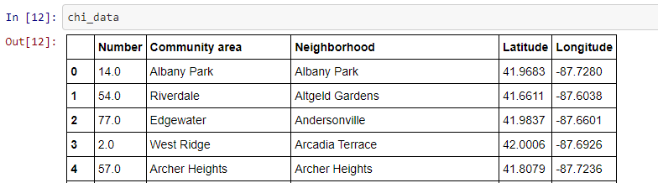
Latitude Longitude
Next, we start gathering latitude and longitude data to plot our map. Our finished product includes columns: Community area, Neighborhood, Latitutde, Longitude

Slide 8
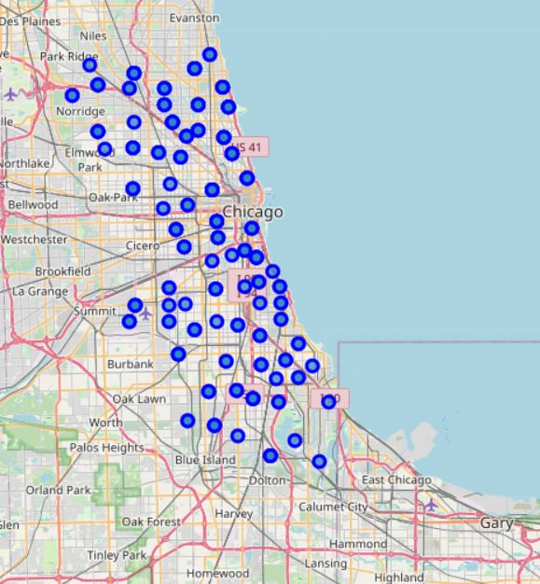
Map
After cleaning our data to eliminate NaN rows, we can plot our initial map:

Slide 9
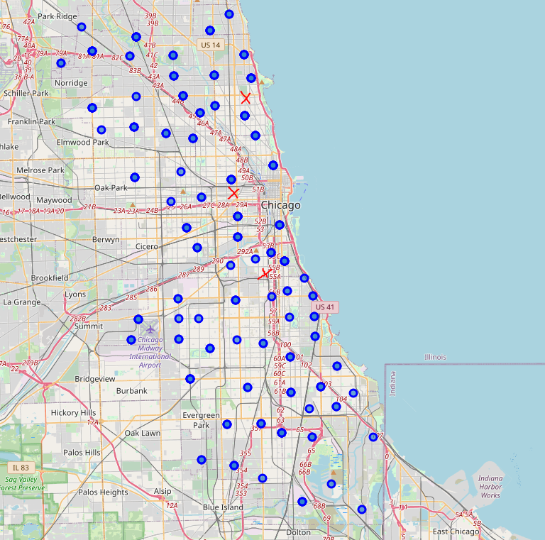
Add Chicago Sports Stadiums

Slide 10
Conclusion
We can see some neighborhoods are closer to the stadiums than other. Furthermore, the Blackhawks and Bulls both play at the United Center in West Loop.
In terms of sports bar density, Lakeview has the highest average count – specifically Wrigleyville where the Cubs play.
Overall, there are places for fans all over the city to watch the team’s games. If I were moving to Chicago, I would prioritize apartments in the West Loop and Wrigleyville area.

